Slide 1


KOREA BLOOMCELL
Advanced biopharmaceutical R&D Company.

Slide 2
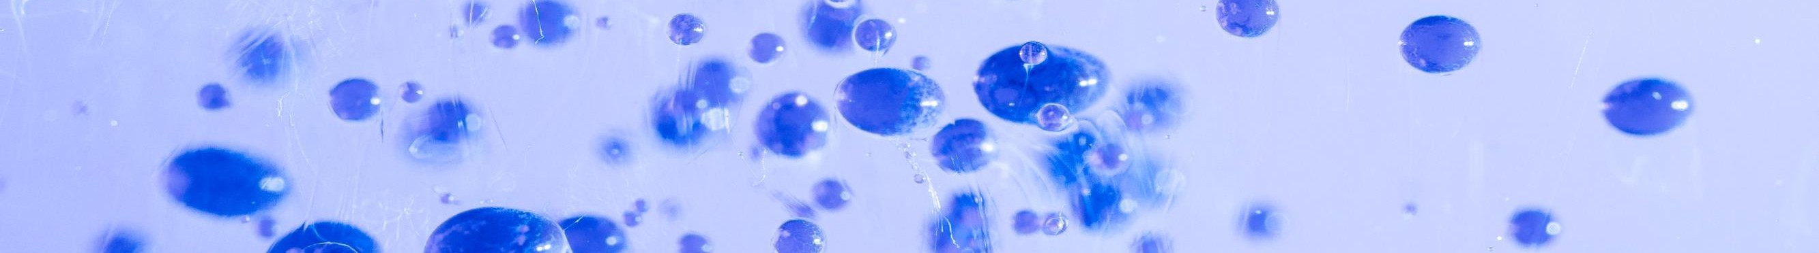
Advanced biopharmaceutical research companies
1
KOREA BLOOMCELL
₀ About Us
₀ Business Area
₀ Market Analysis
1
Organizational structure
Meet Our Leaders
Our Mission
Proprietary Technology
2
Stem cell cultivation
Membrane-free stem cel culture
Stem cell comparison
Stem Cell Utilization Plan -
Therapeutic Development
Developing therapeutics based on exosome isolation
CLEAN MEAT - Foie Gras
3
The state of the global pharmaceutical market
Major drug market by therapeutic area
Biopharmaceutical Markets
Anti-Cancer Market Trends
The Global Market for Immuno-oncology
Immuno-oncology market size
Alzheimer's & Dementia Market
0 Business strategy
(1) Developing the next generation of 0 stem cell research
(2) Natural product bio-development
production
Gene editing technologies
Development of membrane-free stem cell-based exosomes
Development of freeze-drying process technology
₀ Product launch planning
₀ Product sales planning
4
₅ (1) Timeline
(2) Product launch planning
(3) Next step
₆ (1) Product sales plan
(2) Annual Sales

Slide 3

₀ About Us
1
Organizational Structure
Meet Our Leaders
Our Mission
Proprietary Technology

Slide 4
01
KOREA BLOOMCELL
Advanced biopharmaceutical
R&D company
About Us
(1) Organizational structure
CEO
Business Development
R&D
Planning/Marketing
Therapeutics Team 1
Admin / Finance
Therapeutics Team 2
Plant & animal Research
Health Food Team

Slide 5
01
KOREA BLOOMCELL
Advanced biopharmaceutical R&D company
About Us
(2) Meet Our Leaders
Dr. Chun-hong IM
Dr. Chul-gi Min
CEO and Co-Director of Research center
Co-Director of Research center
Current Position:
CEO and Co-Research Director at Korea BLOOMCELL.
Past Positions:
Outpatient Professor at Tianjin Medical University, China.
Researcher at the National Institute of Life Science and Technology, Zhongshan City, Guangdong Province, China.
Research Director at New Generation Life Science Technology Co, a Sino-Korean joint venture affiliated with the National Institute of Life Science and Technology, Zhongshan City, Guangdong Province, China.
President of Zhongshan New Generation Life Science Technology Co.
Deputy Director at Peking Medical Center, Yilao City, Shandong Province, China.
Representative Director of Xinlong Technology.
Co-Representative Director of N-CLONTEC Co., Ltd., Ichao City, Shandong Province.
Head of Oxford Stem Cell Laboratory, University of Oxford, UK.
Educational Background:
University of Oxford, UK - Pathology.
Head of Oxford Stem Cell Laboratory, University of Oxford, UK.
Current and Past Position:
Co-Director of the Korea BloomCell Joint Research Institute.
Ph.D. in Biology from the California Institute of Technology (Caltech), USA.
Graduated with a degree in Biotechnology from Seoul National University.
Served as an exchange professor at the University of California.
Currently, the Director of the B-IT Fusion Biotechnology Consortium.
Former Professor in the Department of Life Science at Ajou University.
Visiting Professor at Dankook University.
Key Research Areas:
Stem Cell Induced Differentiation.
Genetic Therapy involving Growth Factors.
Immunotherapy.

Slide 6
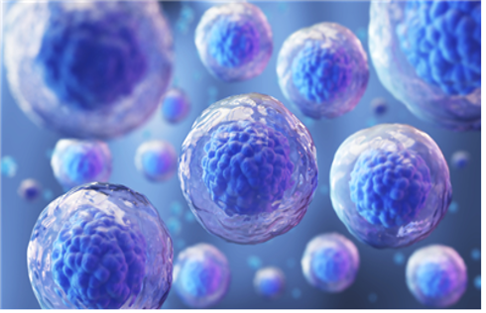
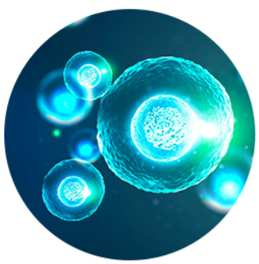
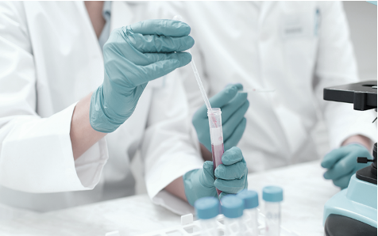
01
About Us
KOREA BLOOMCELL
(3) Our Mission
Advanced biopharmaceutical
R&D company
Leverage proprietary technology to make high-cost treatments affordable, and gain market share
Utilizing decades of research and data based on our proprietary technology to separate exosomes from stem cells.
Research and development of treatments for cancer, Alzheimer's and senile dementia, which are the most intractable diseases of mankind, immune enhancers, and ingredients for health functional foods and cosmetics.
Experience & know-how in stem cell research
Exosome isolation technology and raw materials
Development of therapeutics
- Established R&D Center in Oxford, London, UK
- Established a stem cell therapy research center in Songdo, Incheon
- Partnered with stem cell research centers in major countries around the world
- Established Ichao Stem Cell Therapy Research Center in China
- Held a stem cell therapy seminar
- Acquired a patent for stem cell therapy development
- Possessing original technology unique to Korea BloomCell
- Continuous development research through independent technology and research
- Cancer- Alzheimer's Disease / Senile Dementia
- Nutraceuticals- Cosmetic ingredients
Notes:
Ichao Stem Cell 중국 연구소 이름 확인 바랍니다

Slide 7
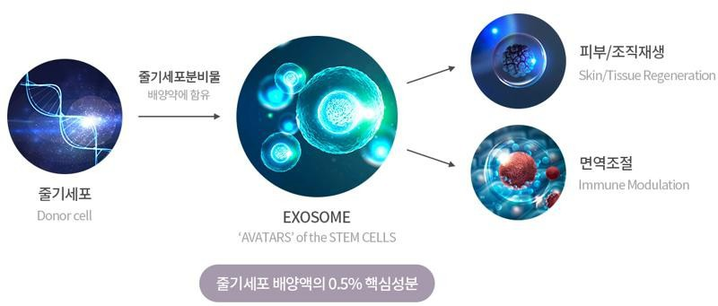
01
About Us
(4) Proprietary Technology
KOREA BLOOMCELL
Advanced biopharmaceutical R&D company
Exosomes not only promote the circulation of RNA and essential proteins among cells (including fibroblasts, keratinocytes, immune cells, etc.) but also play a role in delivering numerous growth factors, cytokines, and genetic materials. This aids in the restoration of skin tissue and enhances the improvement of skin cells.
Notes:
줄기 세포 분비물
배양액에 함유
줄기세포 배양액에 0.5% 핵심 성분
Stem Cell Secretions
In culture medium
0.5% core ingredient in stem cell culture medium

Slide 8

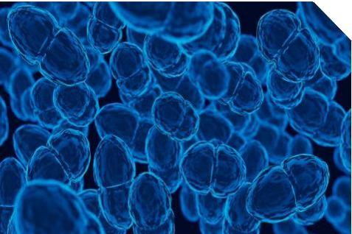
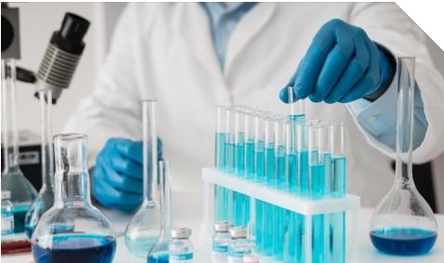

01
About Us
(4) Proprietary technology
KOREA BLOOMCELL
Advanced biopharmaceutical R&D company
Owns original technology for exosome-isolated stem cells
Mass Culture Multiplication Techniques
Possession of original technology to separate exosomes from cord blood stem cells enables mass production of exosomes with enhanced tissue regeneration and inflammation suppression efficacy, rather than simple exosomes.
Separation and culture of exosomes with 2-3 times enhanced functions compared to existing competitors' products is possible
Reducing the cost of producing therapeutics solution
Possess a cancer treatment
Completed preclinical experiments on gene therapy that extracts cells from the ascites of cancer patients and stops cancer cells from proliferating, and has data solutions for conquering cancer. (Pre-clinical data is already available, which is an advantage in terms of clinical period and funds required)
Utilizing membrane-free cell mass culture source technology and 3D stereoscopic culture technology Enables safe mass culture multiplication in an environment similar to the human environment, reducing the price of therapeutics.

Slide 9

₀ Business Area
2
Stem Cell Cultivation
Membrane-free stem cell culture
Stem Cell Comparison
Stem Cell Utilization Plan - Therapeutic Drug Development
Therapeutic Drug Development Based on exosome isolation
CLEAN MEAT - Foie Gras

Slide 10


Business Area
02
KOREA BLOOMCELL
Advanced biopharmaceutical R&D company
(1) Stem Cell Cultivation
A "stem cell" is a cell that has the potential to produce a variety of tissue cells.Play important roles in keeping the body healthy, including healing, blood supply, immune regulation, and anti-apoptosis. Emerging as a solution to intractable diseases
The power of stem cell
Functions of Stem Cels
Wound healing
Self renewal
Finding the site of a wound and regenerating damaged cells
The ability to make cells that are identical to your own
Blood supply
Form blood vessels to supply clean blood
Differentiation
Immunomodulatory function
Cell structure/function changes to fit the unique function of each tissue/cell the structure/function of a cell to fit its unique function.
Govern the organs that control immunity
Specialized features
Healthy cells replace damaged cells
Peripheral secretion signals
Provide various useful secretions from stem cells

Slide 11
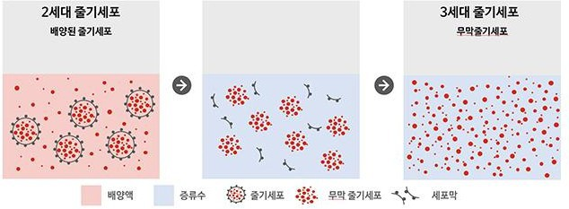
Business Area
02
KOREA BLOOMCELL
Advanced biopharmaceutical R&D company
(2) Membrane-free stem cell culture
Stem cells with their cell membranes removed to eliminate antigens on the cell membrane 260 peptides rich in active ingredients that eliminate immune rejection. Stem cells derived from umbilical cord blood, containing a large quantity of biocompatible components can be used not only as an injection using freeze-drying technology, but also as a raw material for spore cultures, functional cosmetics, and oral treatments.
< Membrane-free stem cell = stem cell with cell membrane removed = protein >
Notes:
2세대 줄기세포 - 2nd Generation Stem Cells
배양된 줄기세포 - Cultured Stem Cells
3세대 줄기세포 - 3rd Generation Stem Cells
무막줄기세포 - Membrane-Free Stem Cells
배양액 - Culture Medium
증류수 - Distilled Water
줄기세포 - Stem Cells
무막줄기세포 - Membrane-Free Stem Cells
세포막 - Cell Membrane

Slide 12

02
Business Area
KOREA BLOOMCELL
(3) Stem cell comparison
Advanced biopharmaceutical R&D company
Stem cells are divided into embryonic stem cells and adult stem cells.
Umbilical cord stem cells are adult stem cells that are close to embryonic stem cells.
Item
Umbilical cord stem cell
Adult stem cells
Adipose Stem Cells
Embryonic stem cells
Hematopoietic stem cells
Source
Ovum, Fertilized Egg
Umbilical cord
Umbilical cord blood
Fat
Ease of Supply
Difficult
Easy
Easy
Easy
Mass Production
Difficult
Easy
Difficult
Easy
Differentiation capabilities
Excellent
(capable of differentiating into 210 human cell types)
Excellent
(There are various human body
Can differentiate into cells)
Capable of differentiation into several cell types
Deficient
Ethical issues
Yes
None
None
None
Teratogenicity
Yes
None
None
None
Graft rejection
Weak
Rarely
Weak
None
Stem cell content
High
High
Low
None

Slide 13
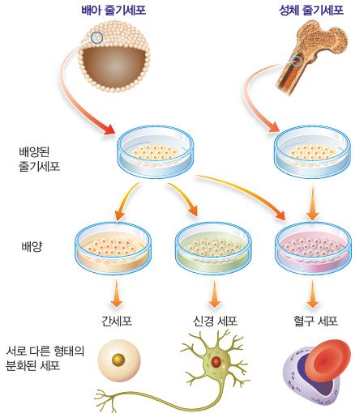
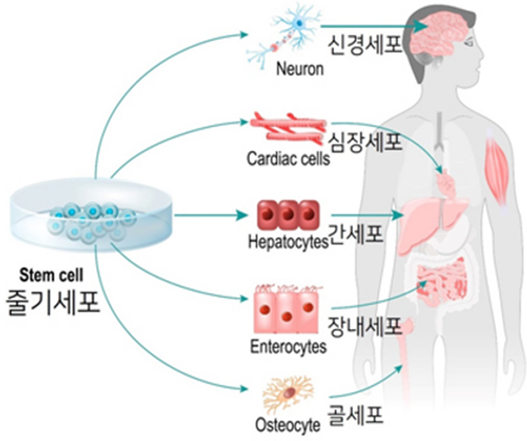
02
KOREA BLOOMCELL
Business Area
Advanced biopharmaceutical R&D company
(4) Stem Cell Utilization Plan - Therapeutic Development
<U.S. News & World Reports
March 2009 Selected incurable diseases that can be treated with stem cell>
Spinal Injuries
Diabetes/Hypertension
Heart disease
Parkinson's disease
Alzheimer's (dementia), autism
ALS(Amyotrophic Lateral Sclerosis)
Lung disease
Arthritis / Acquired Arthritis
Sickle Cell Anemia
Cancer
Repair all organs in the body
Anti Aging
Notes:
배아줄기세포 (Embryonic Stem Cells)
배양된 줄기세포 (Cultured Stem Cells)
배양 (Culturing)
서로 다른 형태의 분화된 세포 (Differentiated Cells of Various Types)
성체 줄기세포 (Adult Stem Cells)
간세포 (Hepatocytes )
신경세포 (Neurons)
혈구세포 (Blood Cells)

Slide 14
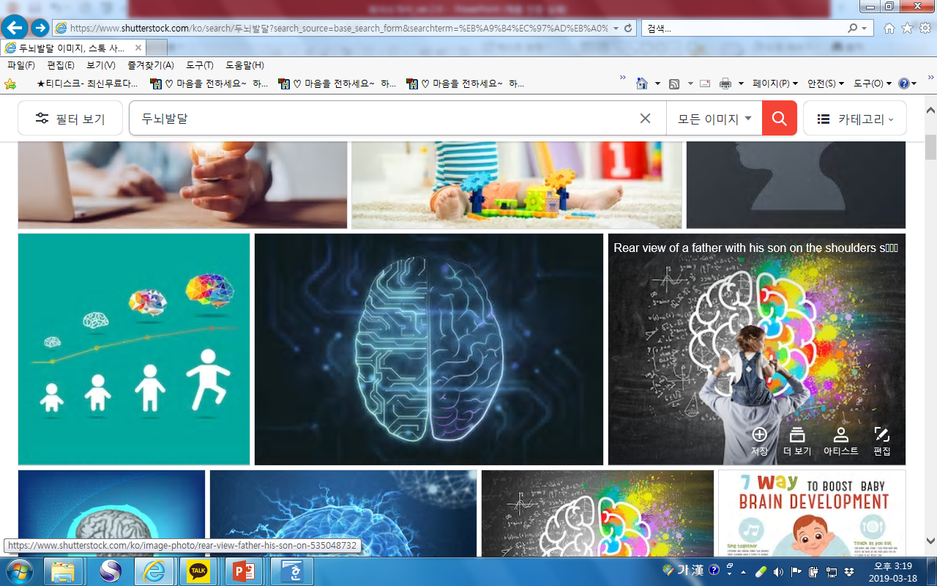
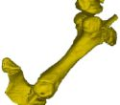
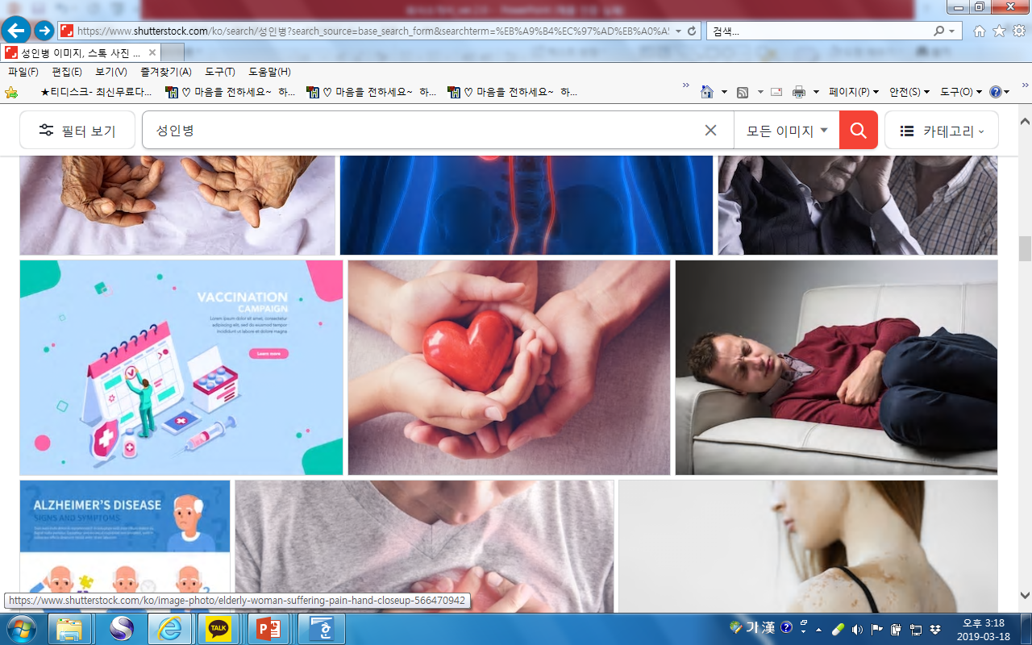
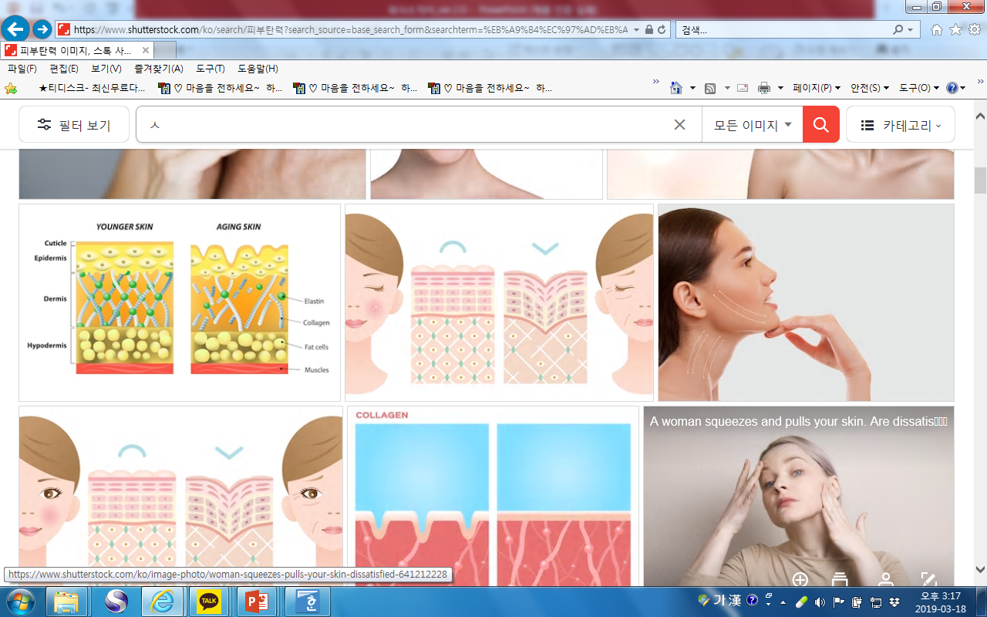
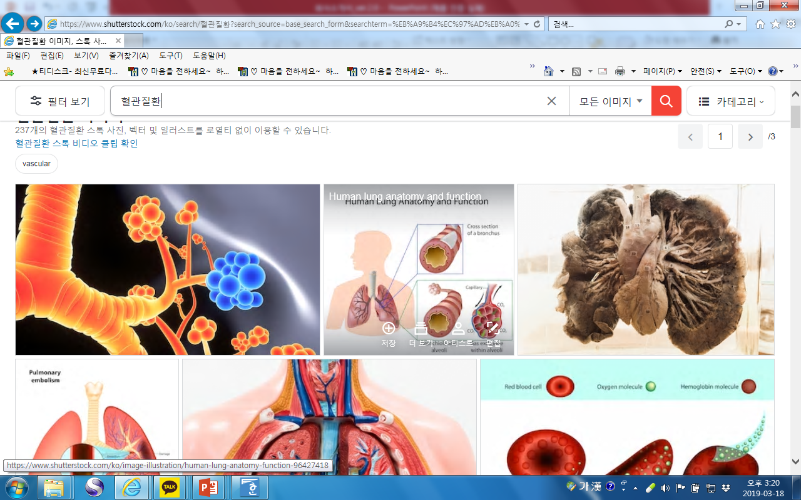
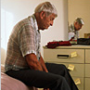
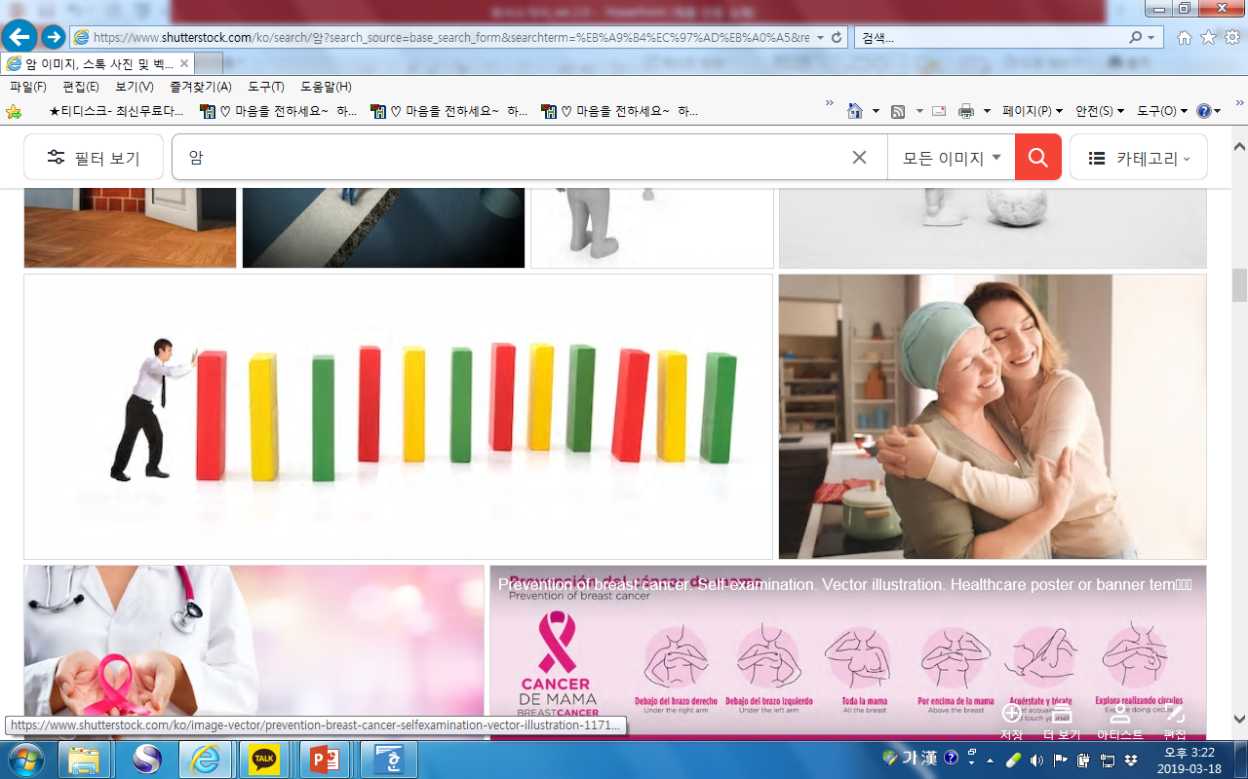
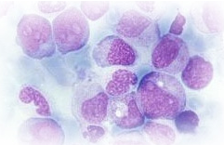
02
Business Area
KOREA BLOOMCELL
(4) Stem Cell Utilization Plan - Therapeutic Development
Advanced biopharmaceutical R&D company
When stem cells are injected intravenously, they differentiate into each organ such as cranial nerves, liver, stomach, spleen, spinal cord, skin, and cartilage, and then engraft and restore damaged cells to their original state - homing effect
The technology is scientifically and clinically proven and can be applied to all organs of the body, from Alzheimer's to leukemia, skin, etc.
Neurological disorders
Alzheimer's (dementia)
Bone Diseases
Cartilage
Heart disease
Heart disease
Skin Diseases
Therapeutics in development
Atopy/Vitiligo
Circulatory Diseases
Bronchial
Brain disorders
Parkinson's/Lou Gehrig's
Cancer
Cancer/Cirrhosis/Fatty Liver
Blood disorders
Leukemia

Slide 15
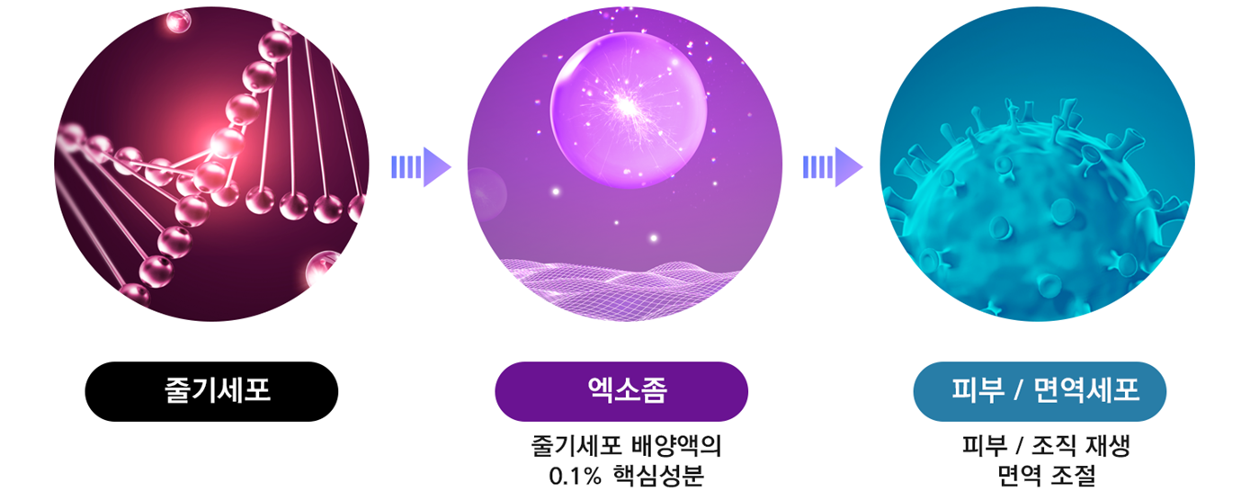
02
Business Area
KOREA BLOOMCELL
(5) Development of therapeutics based on exosome isolation technology
Advanced biopharmaceutical R&D company
Isolates only 0.1% of exosomes from stem cell cultures based on proprietary exosome isolation source technology
This allows it to work effectively on purified, damaged skin to activate the skin's natural energy
Endoplasmic reticulum plays a role in intercellular signaling
Therapeutic benefits of stem cells, such as regeneration, immunomodulation, and anti-inflammation
The active ingredients are delivered to the cells more efficiently, so they work right away.
Notes:
줄기세포 (Stem Cells)
엑소좀 (Exosomes)
줄기세포 배양액의 0.1% 핵심 성분 (0.1% of the Stem Cell Culture Medium is a key component)
피부/면역세포 (Skin/Immune Cells)
피부/조직 재생 (Skin/Tissue Regeneration)
면역 조절 (Immune Regulation)

Slide 16
02
Business Area
KOREA BLOOMCELL
(5) Development of therapeutics based on exosome isolation technology
Advanced biopharmaceutical R&D company
Gene -therapy, a small caveolae containing RNA and protein carriers that are secreted for the purpose of intercellular signaling,
Scalable and flexible new materials for functional cosmetics, including anti-cancer and hair growth agents.
A new generation of promising new materials that secrete enzymes that attack cancer cells by breaking down their barriers.
Intracellular protein therapy is a new technology that enables the development of biologics against targets inside cells strategically based on exosome platforms.
Applications of Skin Exosome Therapy
Outstanding
Cellular Uptake
Treatment of skin conditions
Scar and pore treatment
Rosacea Dermatitis (ROSACEA)
Atopic dermatitis
Acne
Atrophic scar (Atrophic scar)
Enlarged pore
Pigmentation (PIH), burn treatment, etc.
Outstanding
Anti-inflammatory effects
Outstanding
Deliverability
Hair Loss Treatment
Anti-Aging / Aesthetic Treatments
Androgenetic alopecia
Alopecia areata
Female pattern baldness
Improve skin texture and tone
Improve firmness and fine lines
Improve and balance the skin's dermis layer
Outstanding
Safety
Outstanding
Regenerative Effects

Slide 17
02
Business Area
KOREA BLOOMCELL
(6) CLEAN MEAT - Foie Gras
Advanced biopharmaceutical R&D company
Meat that has been artificially cultured from animal stem cells.
Emerging as a viable alternative to meat from traditional animal agriculture in response to resource depletion, etc.
Minimize the environmental impact and carbon footprint of large-scale grazing, breeding, slaughter, and processing (95% reduction possible) Cultured and alternative meats will make up more than half of the meat market in the next 20 years
How to use it
Foie Gras - Fatty Liver
Production funding - totaling KRW 1 billion
Global market size is approximately $5 billion (KRW 6 trillion)
Artificially producing fatty goose liver using stem cell culture technology
A specialty served in France at Christmas and New Year's with red wine, it is one of the top three dishes in the world.
Protein (11%) - Fat (44%) - High-calorie foods high in vitamin A
Developing the best varieties for creating starter cells
Liver can be cultured without serum
Major Facilities
Cell line culture container (clean container) 2set: 40 million won
Container for cell culture (clean container) 5 set: 100 million won
Other equipment (clean bench - centrifuge, etc.): 100 million won
Consumables, reagents, etc.: KRW 100 million

Slide 18
02
Business Area
KOREA BLOOMCELL
(6) CLEAN MEAT - Foie Gras
Advanced biopharmaceutical R&D company
Global market size
Year | Size (＄) | Cultured Meat | Meat substitutes | Traditional Meats
2025 | 1.2 trillion | 0 | 10 | 90
2030 | 1.4 trillion | 10 | 18 | 72
2035 | 1.6 trillion | 22 | 23 | 55
2040 | 1.8 trillion (approximately $200 trillion) | 35 | 40 | 25
(%)

Slide 19

0
3
Market Analysis
The state of the global pharmaceutical market
Major drug market by therapeutic area
Biopharmaceutical Markets
Anti-Cancer Market Trends
The Global Market for Immuno-oncology
Immuno-oncology market size
Alzheimer's & Dementia Market

Slide 20
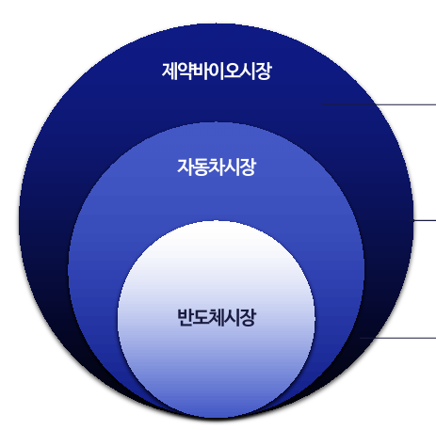
03
Market Analysis
KOREA BLOOMCELL
(1) Global pharmaceutical market status
Advanced biopharmaceutical R&D company
The biohealthcare industry is growing rapidly due to issues such as health, stable retirement, and longevity.
The global biohealth market is larger than the automotive and semiconductor markets combined.
BioHealth: KRW 8,800 trillion / Automotive: KRW 2,700 trillion / Semiconductors: KRW 510 trillion
Market size comparison
Sources: IDC, VDA, WSTS
Biohealth Industry KRW 8.800 trillion
Automotive market KRW 2,200 trillion
Semiconductor market KRW 510 trillion
Notes:
제약 바이오 시장 (Pharmaceutical and Biotech Market)
자동차 시장 (Automobile Market)
반도체 시장 (Semiconductor Market)

Slide 21
03
KOREA BLOOMCELL
Market Analysis
(2) Major drug market by therapeutic area
Advanced biopharmaceutical R&D company
Anti-cancer drugs are the largest market and will continue to grow in the future
Global anticancer drug market to grow from $104 billion in '17 to $233 billion in '20
Cancer is an aging disease, and the world's population is aging rapidly.
Advances in technology have led to much more advanced diagnostics and treatments.
Anti-cancer drugs account for 4 of the top 10 global sales and biopharmaceuticals for 8, driving the global pharmaceutical market
Revenue by therapeutic area
($ billion, %) Source: Evaluatepharma
Top 10 Global Medicines
Source: Strategic Insights Into Biopharmaceuticals Industry
Treatment Area | Revenue in 2017 | Expected revenue in 2024 | Average annual growth rate 2017 to 2024
Cancer (Oncology) | 1,040 | 2,330 | 12.2
Anti-diabetics | 461 | 595 | 3.7
Autoimmune diseases (Anti-rheumatics) | 557 | 567 | 0.2
Vaccines | 277 | 446 | 7.1
Anti-virals | 424 | 399 | -0.9
Immunosuppressants | 137 | 381 | 15.7
Bronchodilators | 272 | 323 | 2.5
Dermatologicals | 129 | 303 | 13.0
Sensory Organs | 216 | 269 | 3.2
High blood pressure (AntiOhypertensives) | 230 | 244 | 0.8
NO | Product Name | Vendor name | Revenue (2017) | classfication
1 | Humira | Abbvie | 18.4 | Monoclonal antibodies
2 | Revlimid | Celgene | 8.2 | Synthetic Drugs
3 | Rituxan | Roche | 7.5 | Monoclonal antibodies
4 | Herceptin | Roche | 7.1 | Monoclonal antibodies
5 | Avastin | Roche | 6.8 | Monoclonal antibodies
6 | Remicade | Johnson & Johnson (J&J) | 5.8 | Monoclonal antibodies
7 | Prevnar 13 | Pfizer | 5.6 | Vaccines
8 | Enbrel | Amgen/Pfizer | 5.4 | Fusion Proteins
9 | Lantus | Sanofi | 5.2 | Manufactured Synthetic Proteins
10 | Lyrica | Pfizer | 5.1 | Synthetic Drugs

Slide 22
03
Market Analysis
KOREA BLOOMCELL
(3) Biopharmaceutical markets
Advanced biopharmaceutical R&D company
1) Biopharmaceuticals are evolving from antibody drugs to improved innovations
Genentec's technology for synthesizing insulin using transgenic E. coli was commercialized in 1982 by Eli Lilly.
Oso Biotech receives FDA approval for OsoClone, an antibody treatment for kidney transplant rejection, in 1987.
Antibody medicines are currently achieving breakthroughs in conditions such as cancer and rheumatoid arthritis.
Improved antibody medicines, such as bi-targeted antibodies and antibody/drug conjugates, are available and in development to increase the range and effectiveness of treatments.
Classification of biopharmaceuticals
Biopharmaceuticals
Biologics
Genetically engineered drugs
Cell culture medicines
Renewable Pharmaceuticals
Vaccines
Blood Products
Antitoxins, etc.
Insulin
Growth Hormone
Interferon, etc.
Cellular Therapeutics
Gene therapy
Antibodies

Slide 23
03
Market Analysis
KOREA BLOOMCELL
(3) Biopharmaceutical markets
Advanced biopharmaceutical R&D company
2) Rapidly expanding biopharmaceutical and biosimilar markets
The biopharmaceutical market will be $311 billion in 2021
- Biologics $280.6 billion (90% share, 6.7% CAGR)
- Biosimilars $30.4 billion (10% share, 30.6% CAGR)
- The biosimilars market is expected to grow at a CAGR of 30.6%, significantly higher than the prescription drug market.
The ratio of chemicals to biopharmaceuticals is expected to increase from 70%:30% in 2022 to 65%:35% in 2026, with biopharmaceuticals taking the lion's share.
Chemical vs Biopharmaceutical Revenue Share & Size
Global Biopharmaceutical Market Outlook
Source: Evaluatepharma (%)
Source: Center for Biotechnology Policy Research ($ billions)
Biotechnology
83
Conventional/Unclassified
Biologics, CAGR 6.7
Biosimilars, CAGR 30.6
48.1
70
41.7
65
35.8
Top 100 medicines
16.1
24.1
30.4
53
12 in 2012
44 in 2020
51 in 2026
57
9.7
2012
62
52
2020
48
2026
43
35
297.9
313.7
325.4
17
244.3
263.1
280.6
30
220.6
2012
2013
2014
2015
2016
2017
2018
2019
2020
2021
2022
2023
2024
2025
2026
2017
2018
2019
2020
2021
2022
2023

Slide 24
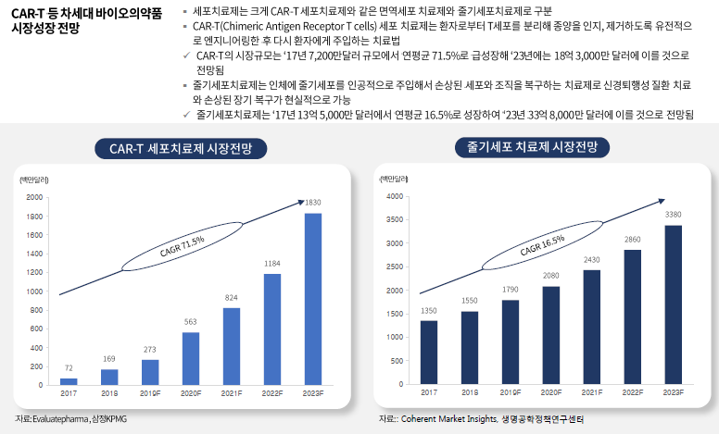
03
Market Analysis
KOREA BLOOMCELL
(3) Biopharmaceutical markets
Advanced biopharmaceutical R&D company
3) Forecasting the market for next-generation biopharmaceuticals such as CAR-T
Cellular therapies can be broadly categorized into immune cell therapies, such as CAR-T cell therapies, and stem cell therapies.
CAR-T (Chimeric Antigen T Cells) cell therapy is a treatment in which T cells are isolated from a patient, genetically engineered to recognize and kill tumors, and then infused back into the patient.
- The market size of CAR-T is expected to grow rapidly from $72 million in '17 to $1.83 billion by '23, at a CAGR of 71.5
Stem cell therapy is the artificial infusion of stem cells into the body to repair damaged cells and tissues, making it a viable option for treating neurodegenerative diseases and repairing damaged organs.
- Stem cell therapies will grow at a CAGR of 16.5% from $150 million in '17 to reach $3.38 billion in '23
Notes:
CAR-T 세포치료제 시장 전망 Outlook of CAR-T Cell Therapy Market
줄기세포 치료제 시장 전망 Outlook of Stem Cell Therapy Market

Slide 25
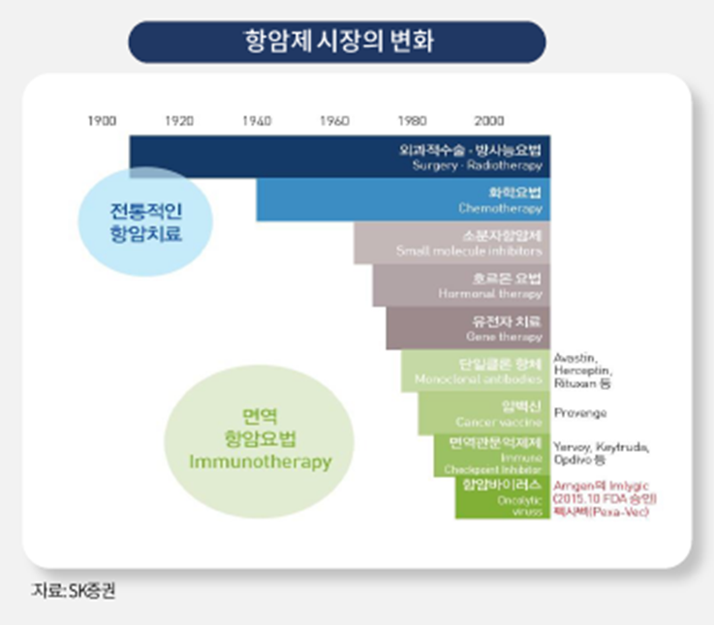
03
Market Analysis
KOREA BLOOMCELL
(4) Anti-Cancer Market Trends
Advanced biopharmaceutical R&D company
3) Forecasting the market for next-generation biopharmaceuticals such as CAR-T
Market shifts to immuno-oncology drugs that stimulate the immune system, have fewer side effects, and can be used in combination.
Immuno-oncology treats cancer by stimulating the immune system; classified into active and passive treatments based on body system
Passive therapy involves injecting components of the immune response into cancer patients to treat them.
- Immune Checkpoint inhibitor, lmmune Cell Thraphy, etc.
Active therapies actively activate an individual's antibodies and immune cells.
- Cancer Vaccine , Immune System modulator, etc.
Notes:
항암제 시장의 변화 Changes in the Cancer Drug Market
전통적인 항암치료 Traditional Cancer Treatments
면역항암요법 Immunotherapy for Cancer

Slide 26
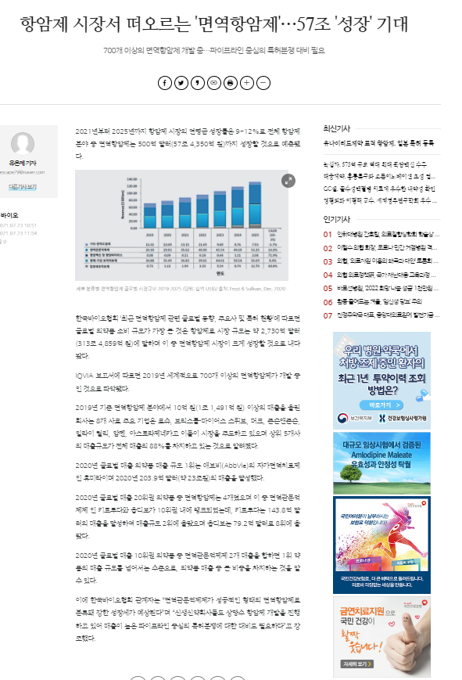
03
KOREA BLOOMCELL
Market Analysis
Advanced biopharmaceutical R&D company
(5) Global Market for Immuno-oncology
Immuno-oncology drugs are drugs that prevent cancer cells from evading the body's immune system or make immune cells better able to recognize and attack cancer cells.
Unlike targeted therapies, it does not require a specific target to be used, so it can be applied to many patients.
Because it works through the immune system, it has fewer side effects than traditional cancer drugs.
The global immuno-oncology market is segmented into immunomodulators, anti-cancer vaccines, adoptive cell therapies, antibody-based targeted therapies, and anti-virals.
Immunomodulators
Includes immune gateway inhibitors and other immunomodulators (cytokines, etc.)
Anti-cancer vaccines
Tumor-specific antigens from cancer cells are given to cancer patients to activate their immune system.
Adoptive Cell Therapy
A cellular therapy in which the body's own immune cells are harvested, enhanced, genetically modified, and reintroduced.
Antibody-based targeted therapies
Exploit the properties of antibodies that selectively bind to target antigens
Monoclonal antibodies are designed to bind to specific parts of cancer cells and can be very effective in treating cancer.
Antiviral
A replicating, immunogenic virus that inserts specific genes that target genetically abnormal sites in cancer cells.

Slide 27
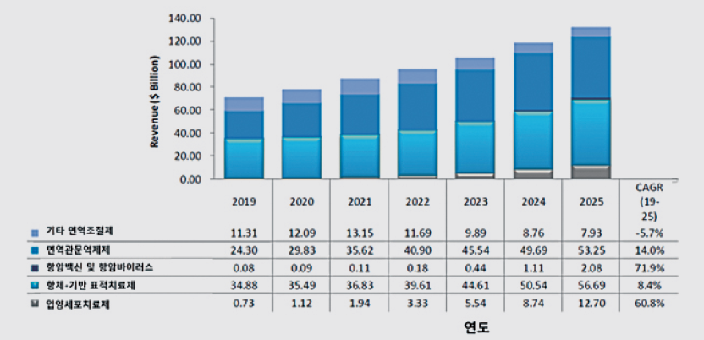
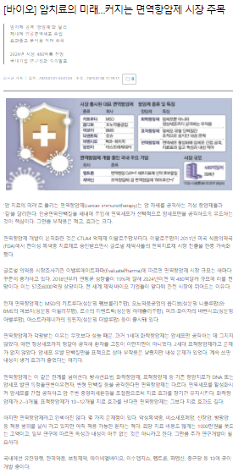
03
Market Analysis
KOREA BLOOMCELL
(6) Global market size of immuno-oncology drugs
Advanced biopharmaceutical R&D company
This is a market that is experiencing steady growth and is the main target market for KOREA BLOOMCELL.

Slide 28
03
KOREA BLOOMCELL
Market Analysis
Advanced biopharmaceutical R&D company
(7) Alzheimer's & Dementia Market
In 2020, the global market for Alzheimer's disease therapeutics was valued at approximately $31.1 billion (~$3.5 trillion), and is expected to more than quadruple by 2024 to form a market of approximately $126.1 billion (~$15.2 trillion).
- Prevalence is expected to increase as the population ages, and demand for treatments will increase as diagnostics improve.
- There is a growing awareness that Alzheimer's is a preventable disease that can be slowed through medication and management.
12,612
(Unit: U$ million)
cagr (2015-2024)= 16.8
8,873
5,819
3,111
2,903
3,791
2,655
2,623
2,683
2,830
2015
2016
2017
2018
2019
2020
2021
2022
2023
2024
 | 2015 | 2016 | 2017 | 2018 | 2019 | 2020 | 2021 | 2022 | 2023 | 2024
Market Size ($M) | 3,111 | 2,655 | 2,623 | 2,683 | 2,830 | 2,903 | 3,791 | 5,819 | 8,873 | 12,612
Source: Datamonitor Healthcare (2016)

Slide 29

0
4
Business strategy
(1) Developing the next generation of 0 stem cell research
(2) Natural product bio-development
production
Gene editing technologies
Development of membrane-free stem cell-based exosomes
Development of freeze-drying process technology

Slide 30
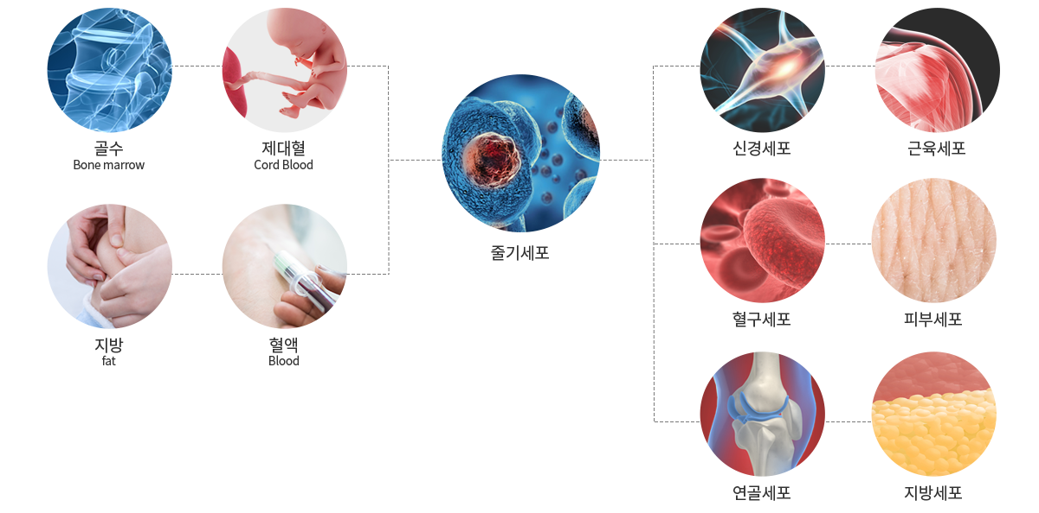
04
Business strategy
KOREA BLOOMCELL
Advanced biopharmaceutical R&D company
Developing biomaterials and exosomes in addition to the stem cell business through its own cord blood stem cell exosome separation technology and membrane-free cell mass culture source technology.
2.
Bio from natural products
Material Development Production
4.
Protein therapy: Development of membrane-free stem cell-based exosomes
5.
Cryobiology-based freeze-drying process technology development
1.
Next Generation Stem Cells
Research and development
3.
Gene
Editing techniques
Notes:
줄기세포 (Stem Cells)
신경세포 (Nerve Cells)
근육세포 (Muscle Cells)
혈구세포 (Blood Cells)
피부세포 (Skin Cells)
연골세포 (Cartilage Cells)
지방세포 (Fat Cells)

Slide 31

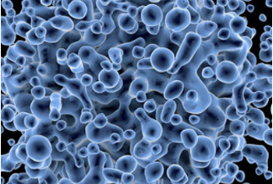

04
Business strategy
KOREA BLOOMCELL
Advanced biopharmaceutical R&D company
1. develop next-generation stem cell research
Live Type Stem Cell Development with Lyophilization Development Technology
Developing the next generation of anti-aging medicines, nutraceuticals (animal), and functional cosmetics using membrane free stem cells.
Combining stem cells and artificial intelligence
- Improve brain cells and brain function to diagnose, prevent, and treat Alzheimer's and dementia
- Research and development of artificial organs using stem cells when organs are damaged
2. develop and produce natural product-derived biomaterials
Development of functional cosmetics using plant stem cells
Developing technology to mass-produce microbial-enabled proteins
Developed technology for mass production of enzymatic biomaterials for food products
3. gene editing technology
Molecular diagnostics, RNAI drug discovery
Animal and plant stem cell culture techniques
Cell injection development technologies

Slide 32
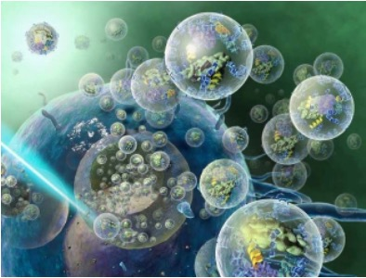

04
Business strategy
KOREA BLOOMCELL
Advanced biopharmaceutical R&D company
4. Protein therapy: Development of membrane-free stem cell-based exosomes
At the heart of the development and treatment of human disease are proteins.
Developing and applying protein therapies to restore function when proteins are excessive, deficient, or have lost their function (membrane-free stem cell-based exosomes)
Developing Nanoparticles (Nanomaterials) Cancer Therapeutics via Exosomes
5. Developed Cryobiology-based freeze-drying process technology
Antifreeze glycoproteins (AFPS) research and development
- Extensive utilization of microbes preserved in permafrost
Life-extension-based technologies to turn back the biological clock

Slide 33

0
5
Product release planning
Timeline
Product launch planning
Next step

Slide 34
05
Product launch planning
KOREA BLOOMCELL
(1) Timeline
Advanced biopharmaceutical R&D company
2022
2023
2024
2025
2026
2027
Lab permits
IRB approval
Permissions/Authorizations
Licensing and selling products
Anticancer drugs
Preclinical approval
Phase I
Phase II
Phase III
Licensing and selling products
Alzheimer's
(exosome)
Preclinical approval
Phase I
Phase II
Phase III
Pre-clinical readiness approval
Immunizations
Phase I
Phase II
Phase III
Health
Food
Product research and sample manufacturing
Licensing and product launches
Sales
Preparing for an IPO
Listing
IPO

Slide 35
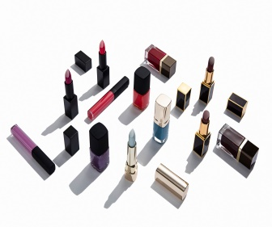
05
KOREA BLOOMCELL
Product launch planning
(1) Timeline
Advanced biopharmaceutical R&D company
Unit: KRW, people
2022
2023
2024
2025
2026
2027
Classification
Q1
Q2
Q3
Q4
Q1
Q2
Q3
Q4
Q1
Q2
Q3
Q4
Q1
Q2
Q3
Q4
Q1
Q2
Q3
Q4
Q1
Q2
Q3
Q4
Anticancer drugs
Preclinical
KRW 1 billion
Phase 1
2 to 5 billion (50 to 100 people)
Phase 2
10 to 30 billion (100 to 200 people)
Phase 3
50 to 100 billion (300 to 100 billion)
Alzheimer's
(exosome)
Preclinical
1 billion
Phase 1
2 billion to 5 billion (50 to 100 people)
Phase 2
10 billion to 30 billion (100 to 200 people)
Phase 3
50 to 100 billion (300 to 100 people)
Preclinical
1 billion
Phase 1
2 to 5 billion (50 to 100 people)
Phase 2
10 to 30 billion (100 to 200 people)
Phase 3
50-100 billion (300 to 100 people)
Immunizations
Preclinical
Phase I
Phase II
Phase III
Duration: 2 years
Cost: 2 to 5 billion
Number of people: 50 to 100
Duration: 2 to 3 years
Cost: 10 to 30 billion
Number of people: 100 to 200
Duration: 2 to 3 years
Cost: 50 to 100 billion
Number of people: 300 to 1,000
Duration: 1 to 2 years
Cost: 1 to 2 billion

Slide 36

05
KOREA BLOOMCELL
Product launch planning
Advanced biopharmaceutical R&D company
(1) Timeline
Stem Cells with a Difference
Original technology for exosome separation
Have a cancer treatment solution
Eternals
Establish a domestic therapeutic/medical device sales network
OOO
Asia/America/Europe/Middle East, etc.
Securing export lines
Mass Culture Multiplication Techniques
Reduce the cost of producing cures
* No additional research required
Gain a technological edge
Lower initial investment
Build collaboration

Slide 37
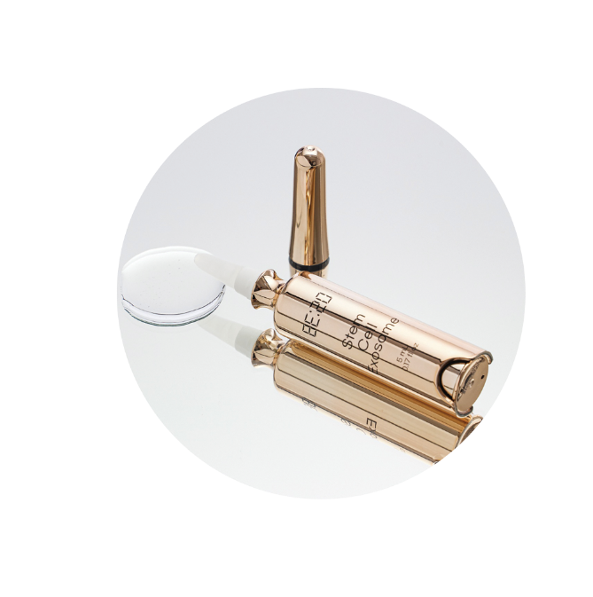
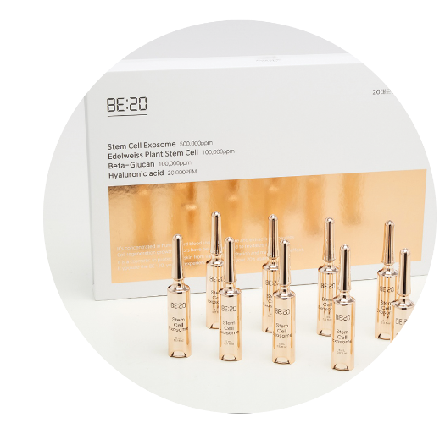
05
Product launch planning
KOREA BLOOMCELL
(2) Product Launch Planning
Advanced biopharmaceutical research companies
Antioxidant patents for skin and scalp protection
Increased cell survival and improved antioxidant efficacy against excessive free radical (H202) oxidative toxicity that leads to skin aging
Significant reduction in fine dust residue (clinical trial completed)
Helps homeostasis, soothe skin, and clean fine dust
Anti-inflammatory and anti-aging patents
Reduced levels of inflammatory factors (clinically studied)
Increased cell survival against oxidative toxicity (clinical trials completed)
Excellent for moisturizing with increased Mrra of moisturizing factor AOP3
(Clinical trial completed)
Clinical anti-wrinkle, lifting care,
Anti-aging, including dermis affinity, moisturizing, etc.
Pore-reducing and sebum-reducing patents
Helps remove inflammation, builds a film, and shrinks skin
Detoxifying, antiseptic, skin constricting, and hemostatic
(pore shrinkage/sebum control), anti-inflammatory
Greenol
Tannin (Tannin Complex HR)
Stem Cell Functional Ampoule KRW 700.000
Edelweiss Stem Cell Culture (Stem cell)
Adenosine
Niacinamide
Ingredients registered for anti-wrinkle by the Ministry of Food and Drug Safety
KFDA whitening registered ingredients

Slide 38

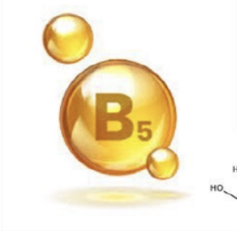
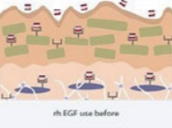
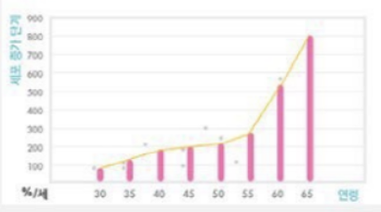
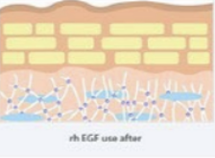
05
Product launch planning
KOREA BLOOMCELL
(2) Product launch planning
Advanced biopharmaceutical R&D company
Complete wrinkle reduction on the face and neck
Amazing skin rejuvenation from the inside out
[ EGF U.S. Patent Clinical Trial Results ].
Lotions formulated with EGF (0.1 ug/ml=0.00001%) had a high of 872% and an average of 284% higher cell growth than lotions without EGF.
Adenosine
D-Panthenol (D-Panthenol)
KFDA-certified anti-wrinkle ingredients
Anti-Wrinkle Ingredient Thresholds
Contains more than 10 times the highest amount (0.4%+)
Cell division and wound healing properties
Natural, non-irritating moisturizing ingredients
EGF (epidermal growth factor) _ a key ingredient in stem cell cosmetics

Slide 39
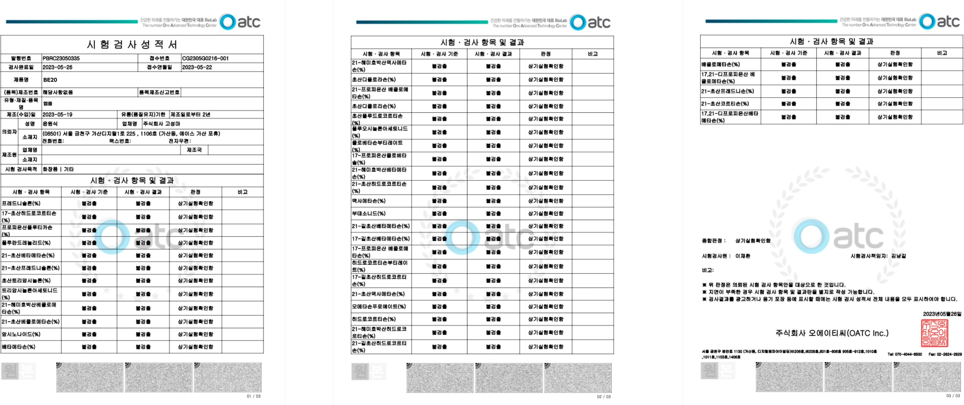
05
Product Launch Planning
KOREA BLOOMCELL
(2) Product launch planning
Advanced biopharmaceutical R&D company
BE:20 Report card for tests with non-detectable harmful ingredients

Slide 40
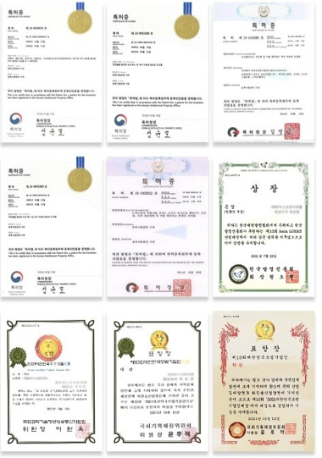
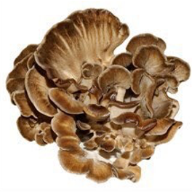
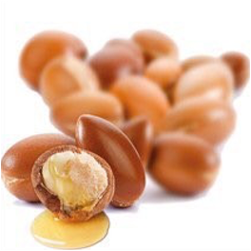
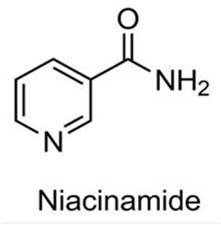
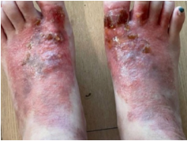
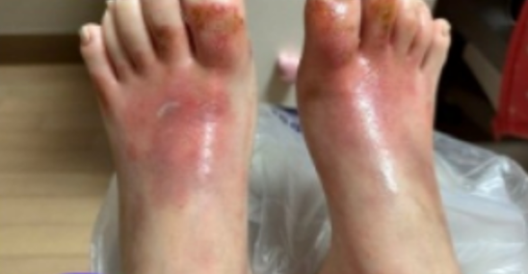
05
Product Launch Planning
KOREA BLOOMCELL
(2) Product launch planning
Advanced biopharmaceutical R&D company
Whitening and breakout relief in one step
Beta-glucan (B-glucan)
Argan Oil
Niacinamide (Vitamin B3)
Protect skin from damage and reduce breakouts
Reduces the appearance of dark spots and blemishes
Water-soluble vitamins with melanogenic properties
KFDA-certified whitening functional ingredients
Immune Boosting Mushroom Extracts
Clear, even skin tone
I am a 24-year-old female with systemic atopy.
The instep area is the most severe, so I'm taking care of that.
September, October, November 2022
That's a change in just three months.
Change after 3 months

Slide 41
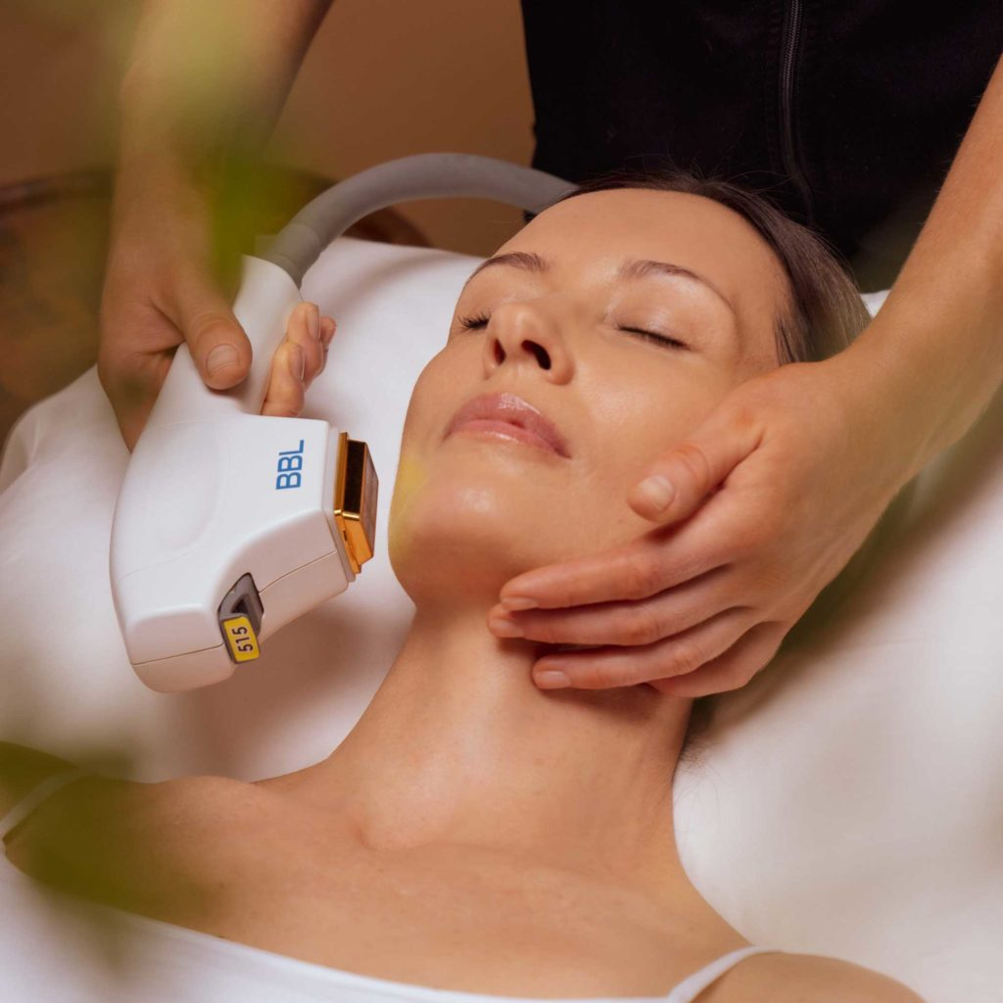
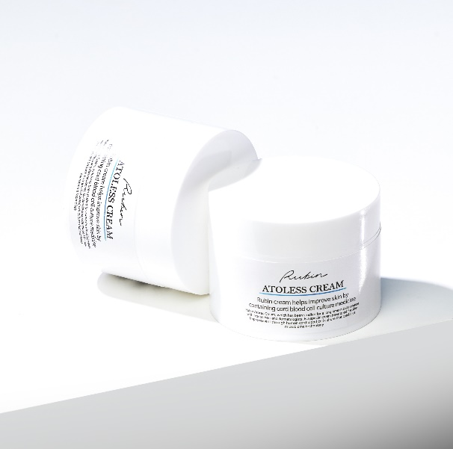
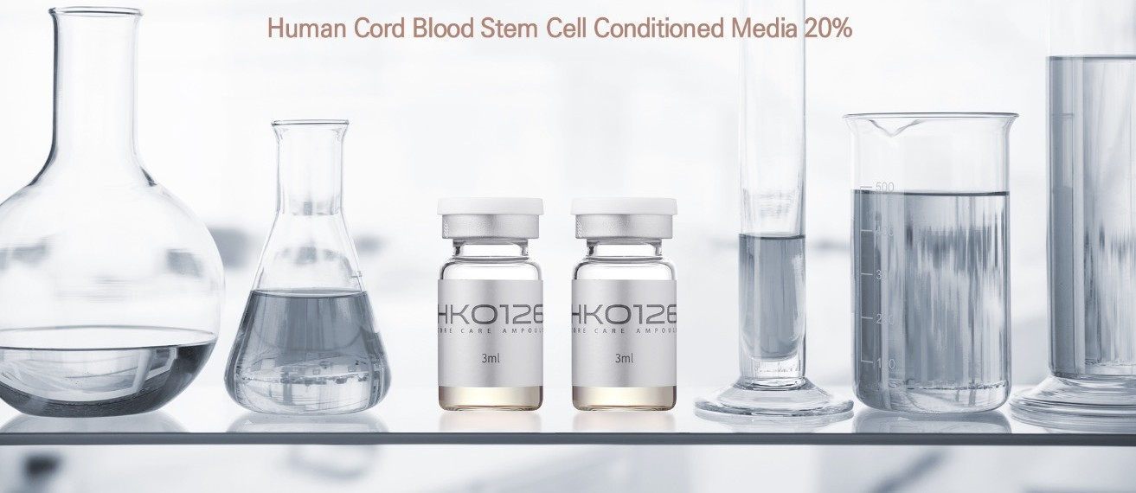
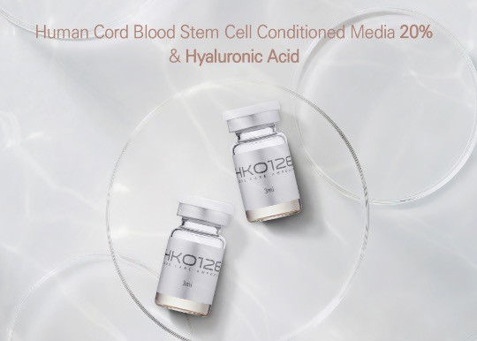
05
Product Launch Planning
KOREA BLOOMCELL
(2) Product launch planning
Advanced biopharmaceutical R&D company
Umbilical Cord Blood Stem CellsExosomesSkin Booster
Cord blood stem cell exosomes 100% (1,000,000 ppm)
Korea Bulum Cell's unique exosome extraction and freeze-drying technology
Contains approximately 260 ultra-high concentrations of growth factors and proteins, including cytokines, SDF-1, EGF-1, and more
Activates skin cells + improves immunity + strengthens skin barrier and self-protection
Exosome Skin Booster
Hospital price KRW 150,000 per vial (5 ml)
Atopic Cosmetics
KRW 99,000
Completed development of exosome skin booster product along with stem cell ampoule, now preparing for mass production
Sells atopic cosmetics for $150,000 per vial (5ml) to hospitals and KRW 99,000 for B2C.

Slide 42
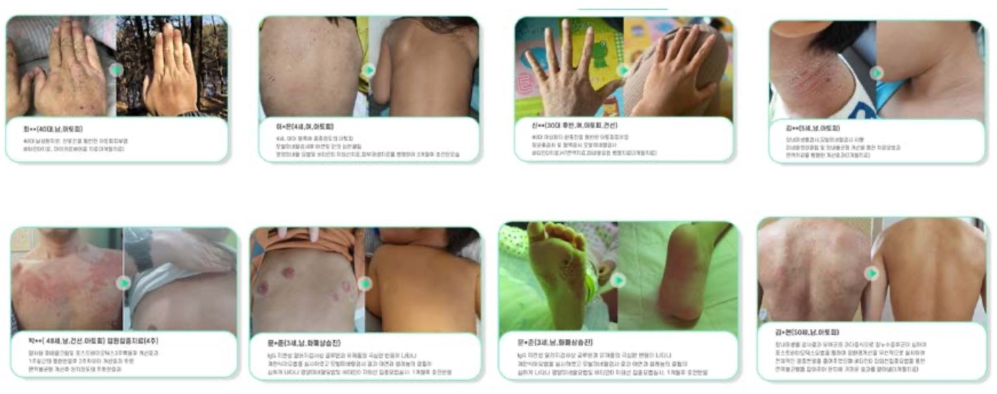
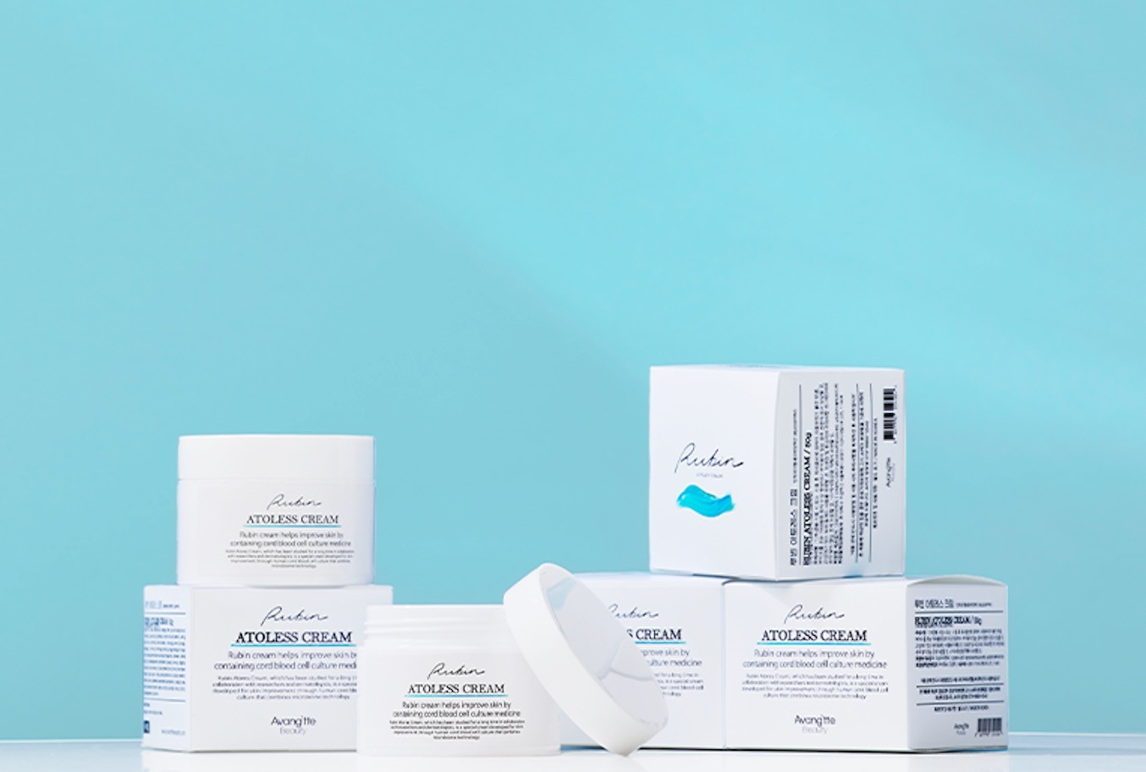
05
Product Launch Planning
KOREA BLOOMCELL
(2) Product launch planning
Advanced biopharmaceutical R&D company
Safe. (100% Organic (All Natural Herbal Ingredient))
This cream is a product made in a new way that is completely different from existing steroid-based ointments, creams, and moisturizing cosmetics. Unlike steroidal products that have side effects when used for a long period of time, this cream has almost no side effects when used to improve atopic dermatitis, psoriasis, and various dermatitis because it is made of the highest quality raw materials that have passed safety tests and does not contain any chemicals.
Enhance the Internal Immune System
Most skin diseases such as atopic dermatitis and psoriasis are caused by an unhealthy internal state of the body that manifests itself on the skin. This product basically balances and strengthens the body's skin immune function to permanently eliminate the underlying cause of dermatitis.
3. eliminate the underlying cause of dermatitis such as atopy and psoriasis (Permanent Cure)
Dermatitis such as atopy and psoriasis are the result of toxins in the body manifesting on the skin. Moisturizing cosmetics such as ointments and creams on the market can only provide temporary improvement. The best way to get rid of dermatitis permanently is to remove the toxins from the body by taking them out of the body (Cure from inside out).
Human Systemic Blood Cells + Microbiome Rubin Atoless Cream is a combination of
The result of this approach is a product that is clearly differentiated from existing products that provide a temporary fix.
A Torres Rubin Cream: 99,000 won

Slide 43
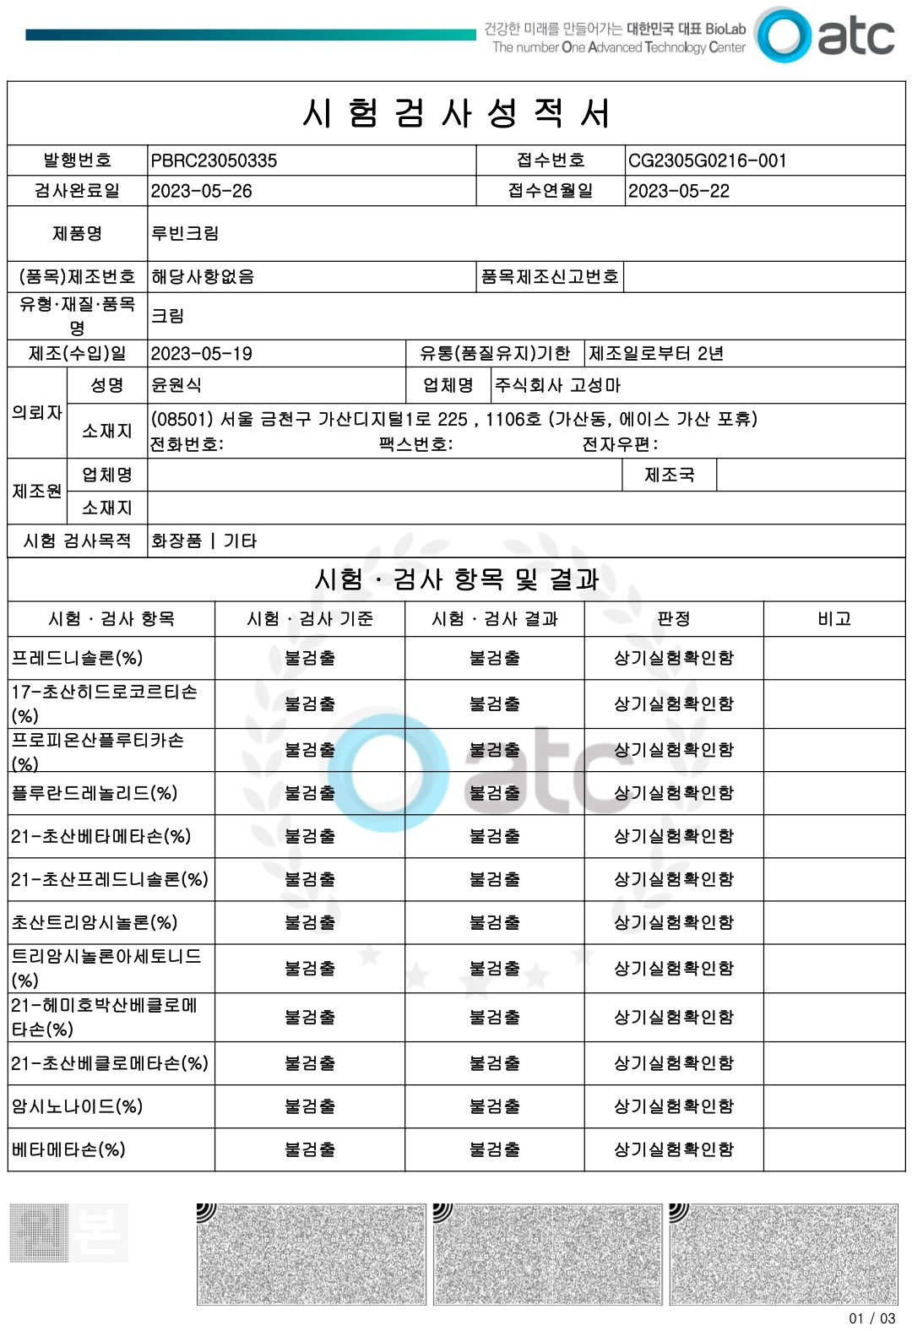
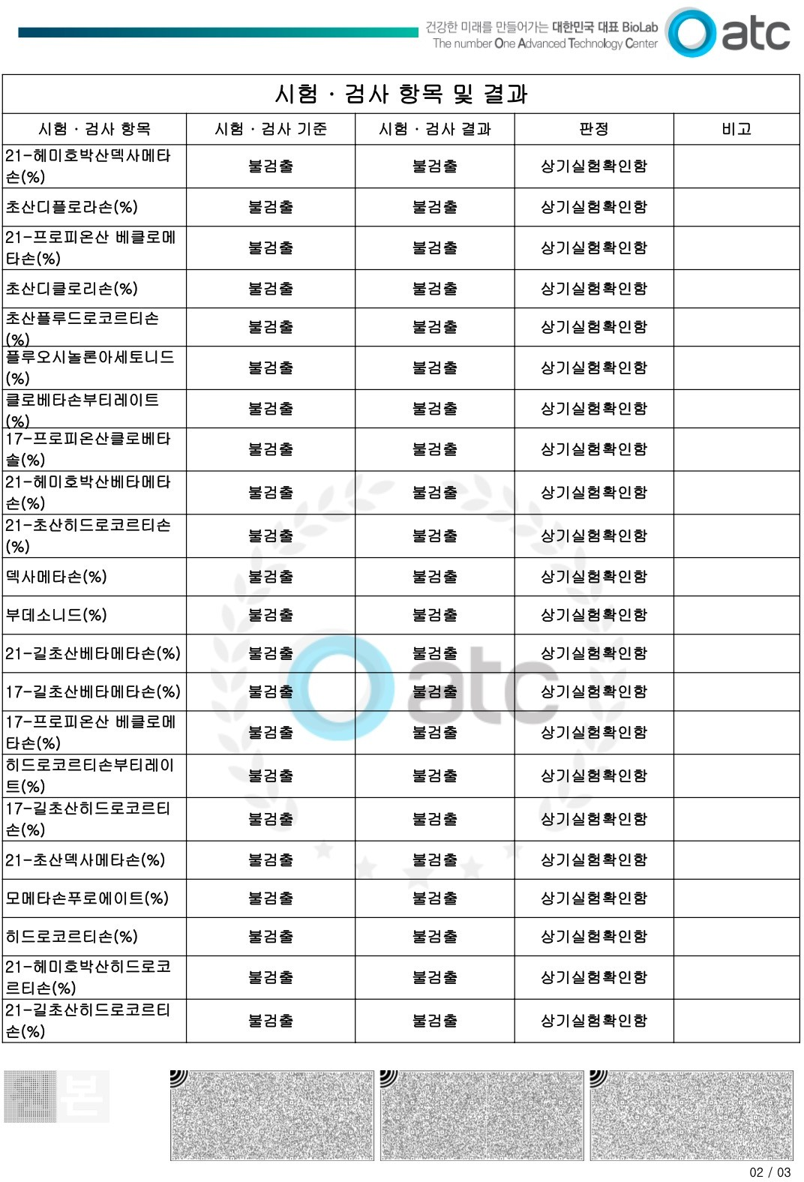

05
KOREA BLOOMCELL
Product Launch Planning
(2) Product launch planning
Advanced biopharmaceutical R&D company
Rubin Cream Steroid Test Results

Slide 44
05
Product Launch Planning
KOREA BLOOMCELL
(2) Product Launch Planning
Advanced biopharmaceutical R&D company
Immunizations, Dietary Supplements (Deer Placenta)
Immune injections are prescribed to boost immunity in patients after cancer and oncology surgeries and to speed up healing of surgical sites, and are currently off-label.
Currently, there are four products: Selenium, Cybosine Alpha 1, Mistletoe, and High-Dose Vitamin C. Korea Bullum Cell's upcoming products have four functions.
(Selenium, Cybosine Alpha 1, Mistletoe, High-dose Vitamin C), which is expected to be easy to enter the market and market.
Korea Bloomcell
Products
Current immunizations, dietary supplement (deer placenta) products
Selenium
Cybocin alpha1
Mistletoe
High-dose vitamin C
Selenium
Cybosine
Alpha1
Mistletoe
High Capacity
Vitamin C
Mixing different functions/areas
Develop as one

Slide 45
05
Product Launch Planning
KOREA BLOOMCELL
(3) Next step
Advanced biopharmaceutical R&D company
5 to 7 years (2nd phase)
Establishing presence in a therapeutic market
Research and development of additional therapies
Going public as a global bio company
Phase 3 approval for anti-cancer/Alzheimer's (exosomes)
For Immuno-injection launches preclinical and clinical approval
Internalization of business and establishment as a biopharmaceutical company
3 to 5 years (leap year)
The Second Leap
Anticancer Preclinical Preparation AuthorizationAlzheimer's (Exosome) Preclinical Preparation ApprovalFurther development of dietary supplements
2-3 years (growth phase)
5 to 7 years
Leapfroggers
3 to 5 years
Year 1 (Stabilization)
Growing up
2 to 3 years
Stabilizers
Lab permits
Secure SBA funding
Secure R&D costs and grow revenue by launching health functional food products
Year 1

Slide 46

0
6
Product sales and revenue Planning
(1) Product sales plan
(2) Annual Sales

Slide 47

06
Product sales and revenue
KOREA BLOOMCELL
(1) Product sales plan
Advanced biopharmaceutical R&D company
Exosome skin boosters are available for immediate delivery, especially for plastic surgery and dermatology
National dermatology growth has been 34% over the past decade, with plastic surgery at 30%.
Sell products to the ever-growing domestic dermatology/plastic surgery market

Slide 48
06
Product sales and revenue
KOREA BLOOMCELL
(1) Product sales plan
Advanced biopharmaceutical R&D company
Stem cells are being labeled as a 'green' technology that can replace animal testing and can be used to produce eco-friendly cosmetics such as 'vegan'.
The company's exosome-based cosmetics have anti-aging properties, so it is tapping into this anti-aging market.
Global Vegan Cosmetics Market Growth Forecast (2018 to 2025)
Global Anti-Aging Therapeutic Services Market
Vegan cosmetics market size
7.5
Year-over-year growth (%)
6.2
Growing at an average of 6.3% annually
5.7
5.2
4.7
Market Size ($ 100 million )
$ 20.8 billion
738.2
855.5
$ 12.9 billion
695.3
625.3
657.6
2017
2025
2017
2018
2019
2020
2022
Source: Grand View Research
Source: Center for Biotechnology Policy Research

Slide 49
06
Product sales and revenue
KOREA BLOOMCELL
(2) Annual Sales
Advanced biopharmaceutical R&D company
In the case of stem cell ampoules, the price per unit is 350,000 won, and the total number of plastic surgeries and dermatologists in Korea is more than 2,300, and B2B sales are conducted to these companies.
Estimated 20% of 2,300 companies as potential customers, with a goal of delivering to 460 companies
Delivered an average of 1.8 deliveries per month to over 460 customers, 21 deliveries per year, and achieved over KRW 12.2 billion in revenue when combined with B2C sales.
 | 2024 | 2025 | 2026 | 2027
Stem Cell Functional Ampoules B2B sales volume | 10,000 | 20,000 | 40,000 | 70,000
Stem Cell Functional Ampoules B2C sales volume | 25,000 | 40,000 | 70,000 | 90,000
Sales total | 35,000 | 60,000 | 110,000 | 160,000
Sales total (KRW) | 12.25 billion | 21 billion | 385 billion | 560 billion won

Slide 50
06
Product sales and revenue
KOREA BLOOMCELL
(2) Annual Sales
Advanced biopharmaceutical R&D company
Exosome skin booster is delivered to hospitals at a price of 150,000 won per unit, and B2B sales are conducted to more than 2,300 plastic surgeries and skin clinics nationwide.
Expected high sales volume at a low price of KRW 150,000 compared to stem cell ampoules costing KRW 350,000 per unit
Atopic cosmetics can be sold and delivered both B2B and B2C. Expected to expand sales volume from 2026 due to exports
 | 2024 | 2025 | 2026 | 2027
Exosome Skin Booster B2B sales volume | 20,000 | 30,000 | 50,000 | 90,000
Exosome Skin Booster B2C sales volume | 30,000 | 50,000 | 70,000 | 100,000
Sales of atopic cosmetics | 50,000 | 80,000 | 100,000 | 120,000
Sales total (KRW) | 12.45 billion | 19.92 billion | 279 billion won | 403.8 billion

Slide 51
06
Product sales and revenue
KOREA BLOOMCELL
(2) Annual Sales
Advanced biopharmaceutical R&D company
In 2024-2025, clinical costs are expected to be in the range of KRW 220-600 billion, all of which can be offset by revenue.
After all clinical trials are completed in 2026, we will start exporting not only domestically but also to full-scale overseas markets.
In China, the total sales of cosmetics is KRW 71 trillion, so we are focusing on the North American and Chinese markets.
Unit: KRW billion
 | 2024 | 2025 | 2026 | 2027
Stem Cell Functionality Ampoule sales | 12.25 | 21 | 38.5 | 56.0
Exosome Skin Booster Revenue | 75 | 12.0 | 18.0 | 28.5
Sales of atopic cosmetics | 4.95 | 7.92 | 99 | 11.88
Sales total | 24.7 | 40.9 | 66.4 | 96.3

Slide 52

KOREA BLOOMCELL
Thank you.
첨단 바이오 의약품 연구 기업

